Slide 1
Low-Level Optimizations for Improving Latency
How CPUs actually spend your nanoseconds - branches, caches and memory

Slide 2
What "Low-Level" Optimization Actually Means
Any latency-sensitive system - trading engines, real-time bidding, telecom switches, game netcode, embedded control loops - gets optimized broadly at two different layers.
High-Level Optimizations
Low-Level Optimizations
High-level / design optimizations change what work gets done: picking a better algorithm or data structure, reducing the number of network hops, batching or eliminating unnecessary work, redesigning the architecture so less has to happen per request.
These decisions are usually visible in a design doc, and their payoff is measured in algorithmic complexity or system topology.
Low-level optimizations change how the CPU carries out work that's already been decided on. They operate below your algorithm entirely - inside the instruction pipeline, the cache hierarchy, and the memory subsystem.
You can have the asymptotically optimal algorithm and still lose meaningful time to how the underlying hardware actually executes it - a gap the design layer never accounted for.

Slide 3
Major Sources of Latency
1
Branch Mispredictions
2
Cache Misses
The CPU pipeline must halt and flush its state when a predicted path turns out wrong, discarding speculatively executed instructions.
The CPU stalls whenever the instructions or data it needs aren't sitting in the cache hierarchy.
3
Memory Allocation Overhead
4
Unoptimized Memory Access Patterns
Dynamic allocation drags in system calls and heap bookkeeping right when you can least afford the delay.
Scanning backwards, jumping across large strides, or chasing pointers defeats the CPU's ability to predictively pipeline your data.

Slide 4
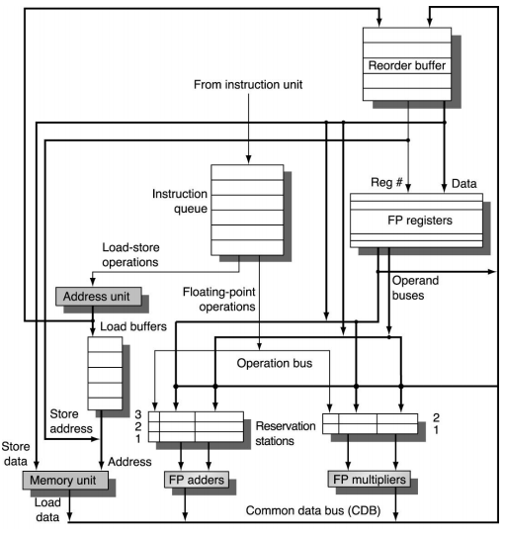
Branch Prediction: The Mechanics
To keep its pipeline full, the processor evaluates upcoming branches and guesses which path will be taken - before the actual condition has been evaluated.
Speculative execution: The processor fetches and executes instructions from the predicted path immediately, banking on the guess being right.
The reorder buffer makes it safe to undo: speculative results sit in ROB entries as tentative and only commit in program order - so a misprediction just discards the younger entries instead of undoing the real state.

Slide 5
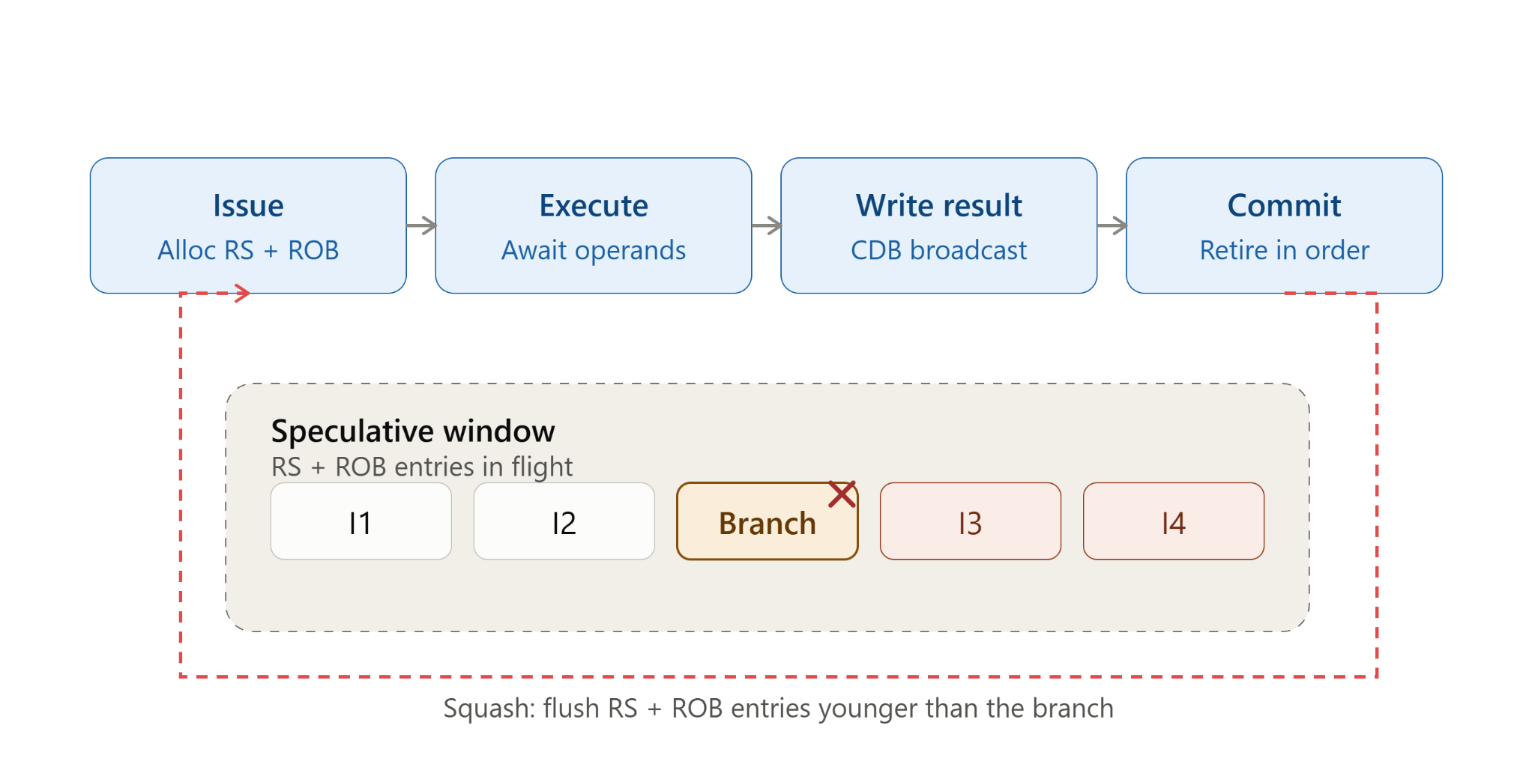
Branch Prediction: The Mechanics
The misprediction penalty: If the guess is wrong, every speculatively executed instruction downstream has to be thrown away, and the pipeline has to be refilled from the correct address.
In a superscalar core with multiple pipelines running in parallel, a misprediction is even more expensive, because all in-flight pipelines have to be flushed together, not just one.
Excessive mispredictions may also cause instruction cache misses.

Slide 6
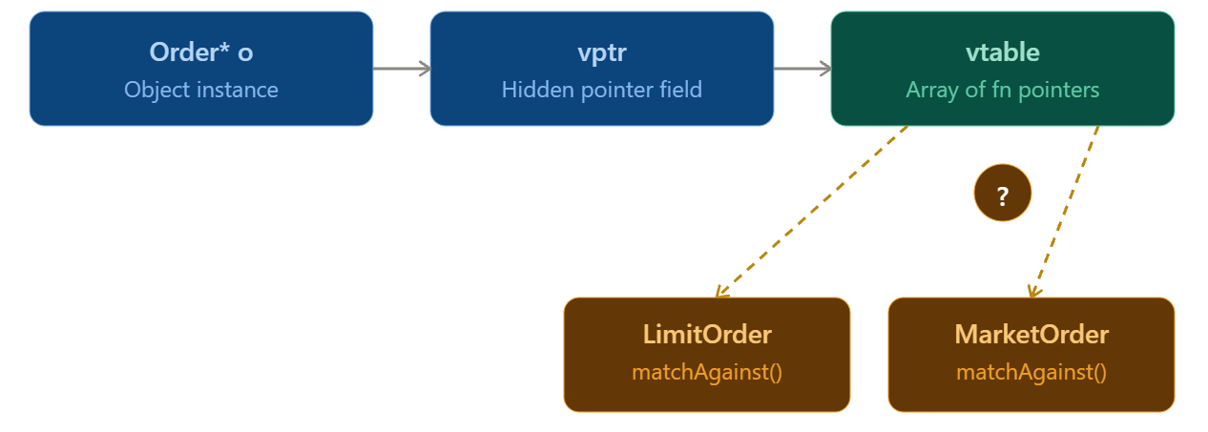
Where Branches Actually Hide
Standard conditional blocks: if, if-else, switch
Loop conditions and control flow: for, while, break, continue
The ternary operator ?: (unless the compiler optimizes it away)
Short-circuiting logical operators: && and ||
Virtual function calls and function pointers introduce indirect branches - the CPU doesn't have to predict taken/not-taken, it has to predict which address to jump to.

Slide 7
Hardware Branch Heuristics (What the CPU Assumes by Default)
`if` is assumed more likely than `else`. Compilers and CPUs both bias toward the if block being the common path - so put your hot/common case in the if, and push error handling into the else.
Loops are assumed to iterate multiple times. The first pass through a loop might be treated as an outlier; subsequent iterations get predicted as “loop continues.”
Backwards branches are assumed to be loop iterations and are favored. A branch that jumps to a lower address (typical of a loop's back-edge) is statically predicted taken.
These are just fallback heuristics for when there's no runtime history yet (cold branches, first execution). Once the branch predictor has seen the branch execute a few times, it switches to using actual history.

Slide 8
Strategies To Reduce Branch Mispredictions
The simplest way to avoid branch prediction issues is to eliminate branches from the hot path altogether.
Algorithm reorganization: Refactor away from unpredictable conditions - anything driven by random numbers, arriving market data, or user input is inherently hard for the predictor to learn. Also flatten long if-else-if chains and deeply nested conditionals; each level is another chance to mispredict.
Deferring error checks: Instead of checking five different error conditions at five different points, combine them into a single validation pass with one branch at the end. One mispredictable branch beats five.
Compile-time resolution: Anything that's knowable at compile time - feature flags, instrument configuration, build-mode switches - should be resolved with #ifdef’s, constexpr or templates so the branch is gone from the generated assembly entirely.

Slide 9
Compile-time Resolution
Runtime Branching
Compile-time Resolution
bool enableRiskChecks = config.readBool("risk_checks");
Result processOrder(const Order& o) {
// still a live branch at runtime
if (enableRiskChecks) {
auto r = runRiskChecks(o);
if (!r.ok) return reject(o, r.reason);
}
return orderGateway.submit(o);
}
template <bool EnableRiskChecks>
Result processOrder(const Order& o) {
// resolved by the compiler
if constexpr (EnableRiskChecks) {
auto r = runRiskChecks(o);
if (!r.ok) return reject(o, r.reason);
}
return orderGateway.submit(o);
}

Slide 10
Branchless Programming: Ternary & CMOV
Replacing a simple if-else assignment with the ternary operator ?: gives the compiler the option to emit a CMOV (conditional move) instruction instead of a branch - as long as both sides of the : are simple expressions with no side effects.
CMOV computes both possible results and conditionally selects one - there's no branch for the predictor to get wrong, because there's no branch at all.
This matters most for data-dependent conditions the predictor genuinely can't learn - where the outcome is essentially random from the CPU's point of view.
Branchless max via ternary
inline int max(int a, int b) {
return (a > b) ? a : b;
}
// On x86-64 with -O2, this typically compiles to:
// cmp eax, edx
// cmovl eax, edx
// check on https://godbolt.org

Slide 11
Branchless Programming: Boolean Arithmetic
Booleans in C++ implicitly convert to 0 or 1 as integers. That means you can fold a conditional increment/decrement directly into arithmetic instead of branching on it.
This pattern shows up constantly in order-book bookkeeping: counting fills, tallying rejected orders, tracking how many price levels were touched by a sweep.
The rule of thumb: if your if branch only does simple arithmetic, you can probably replace it with something like
x += (int)condition;.
Branching counter update
int aggressiveFills = 0;
for (const Fill& f : fills) {
if (f.crossedSpread) aggressiveFills++;
}
Branchless boolean arithmetic
int aggressiveFills = 0;
for (const Fill& f : fills) {
aggressiveFills += static_cast<int>(f.crossedSpread);
}
// f.crossedSpread is already 0 or 1 as a bool

Slide 12
Branchless Programming: Bitwise Masking
You can turn a boolean condition into a bitmask by casting it to a signed integer and subtracting 1.
false becomes -1 (all bits set, 0xFFFFFFFF), true becomes 0 (all bits unset).
ANDing a value against that mask conditionally zeroes it out - with no branch involved.
This trick can be used for branchless RELU implementations, risk checks that zero out an order quantity when a limit is breached, etc.
Use this if the compiler is not optimizing ternary operator to CMOV.

Slide 13
Branchless Programming: Bitwise Masking
Branching RELU
// Branching version - clamp signal to non-negative
inline int RELU(int x) {
if (x < 0) return 0;
else return x;
}
Branchless via subtraction mask
// Branchless version using a bitmask
inline int RELU(int x) {
unsigned int mask = static_cast<unsigned int>( (int)(x < 0) - 1 );
// you can also sign extend a signed integer to use as mask
// unsigned int mask = ~static_cast<unsigned int>(x >> 31);
return x & mask;
}

Slide 14
Branchless Programming: Precomputed Lookup Tables
When a function's output only depends on a small, bounded set of inputs, replace the entire decision tree with a flat array lookup - trading a chain of branches for a single, predictable memory read.
The standard library's character classification functions (isdigit, isalpha, etc.) work exactly this way internally: a precomputed 256-byte table instead of a cascade of range comparisons.
In a market-data parser, this pattern is a natural fit for classifying message types, order sides, or exchange-specific status codes - anywhere you'd otherwise write a switch over a small enum.

Slide 15
Branchless Programming: Precomputed Lookup Tables
Branch chain
Lookup table
enum MsgType : uint8_t { UNKNOWN, NEW_ORDER, CANCEL, REPLACE, EXEC_REPORT };
inline MsgType classify(char c) {
MsgType type = UNKNOWN;
if (c == 'D') type = NEW_ORDER;
else if (c == 'F') type = CANCEL;
else if (c == 'G') type = REPLACE;
else if (c == '8') type = EXEC_REPORT;
return type;
}
enum MsgType : uint8_t { UNKNOWN, NEW_ORDER, CANCEL, REPLACE, EXEC_REPORT };
constexpr std::array<MsgType, 256> buildMsgTypeTable() {
std::array<MsgType, 256> table{};
table.fill(UNKNOWN);
table[static_cast<uint8_t>('D')] = NEW_ORDER;
table[static_cast<uint8_t>('F')] = CANCEL;
table[static_cast<uint8_t>('G')] = REPLACE;
table[static_cast<uint8_t>('8')] = EXEC_REPORT;
return table;
}
static constexpr auto kMsgTypeTable = buildMsgTypeTable();
inline MsgType classify(char c) {
return kMsgTypeTable[static_cast<uint8_t>(c)];
}

Slide 16
Compiler Hints: [[likely]], [[unlikely]], __builtin_expect
Sometimes you can't remove the branch - but you can tell the compiler which side is almost always expected to win, so it lays out the generated code to favor that path.
C++20: [[likely]] and [[unlikely]] attributes on branch statements.
Pre-C++20 / GCC extensions: __builtin_expect(expression, expected_value), usually wrapped in LIKELY() / UNLIKELY() macros for readability.
These are hints, not guarantees - the compiler is free to ignore them.
Use these to direct the flow in case of rarely executed paths, like error handling, where the latency for the error path doesn’t matter as much.
A badly placed [[unlikely]] on an actually-used latency sensitive path can noticeably hurt performance, causing worse tail latencies (e.g. 90th percentile onwards).

Slide 17
Compiler Hints: [[likely]], [[unlikely]], __builtin_expect
C++20 attributes
Pre-C++20 GCC built-in
Result processOrder(const Order& o) {
if (o.quantity <= riskLimit) {
return orderGateway.submit(o);
}
else [[unlikely]] {
return rejectOrder(o, RejectReason::RISK_LIMIT);
}
}
#define LIKELY(x) __builtin_expect(!!(x), 1)
#define UNLIKELY(x) __builtin_expect(!!(x), 0)
// double negation allows cleaner type conversion to long
Result processOrder(const Order& o) {
if (LIKELY(o.quantity <= riskLimit)) {
return orderGateway.submit(o);
}
else {
return rejectOrder(o, RejectReason::RISK_LIMIT);
}
}

Slide 18
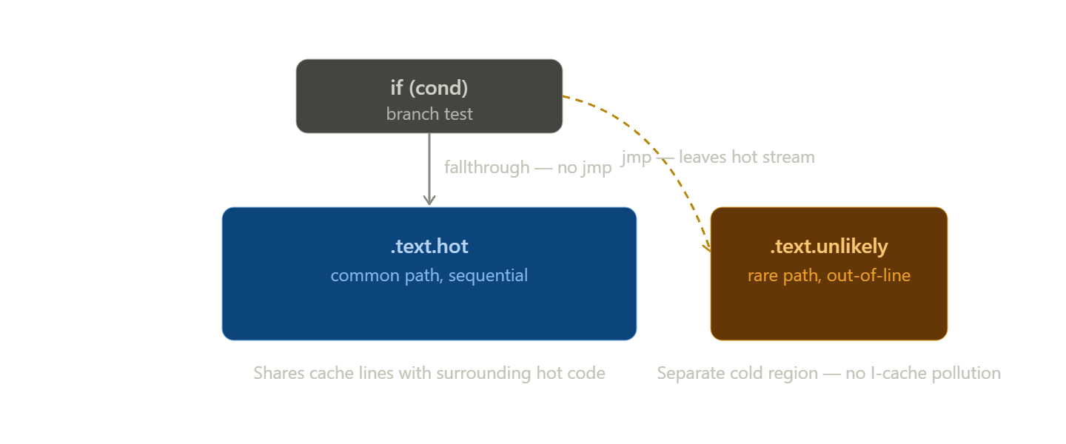
Code Layout Restructuring caused by the Compiler Hints
Compilers use the [[likely]]/[[unlikely]] hints to physically reorder the generated assembly.
The “likely” path is placed immediately after the branch test with no jump needed at all - a straight fallthrough. This maximizes instruction-cache locality: the CPU just keeps reading forward.
The “unlikely” path gets pushed completely out-of-line into a separate cold region of the binary (commonly the .text.unlikely section), so it doesn't pollute the instruction cache with code that almost never runs.

Slide 19
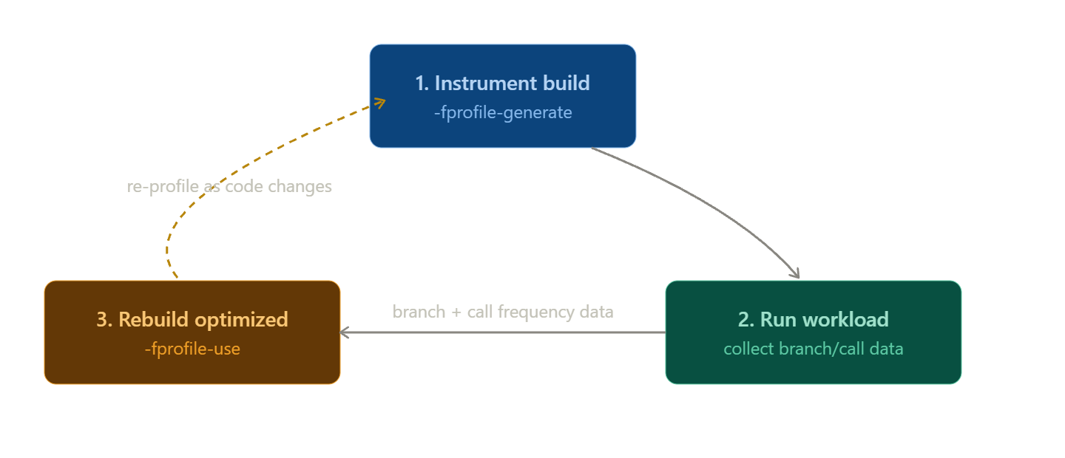
Profile-Guided Optimization
Profile-Guided Optimization (PGO) uses past execution data to determine hot/cold branches and functions:
  Build with -fprofile-generate - this instruments the binary with counters.
  Run it against a realistic workload (replayed market data, a captured trading session).
  Rebuild with -fprofile-use, feeding the recorded branch frequencies and hot/cold block data back into the compiler.

Slide 20
The Memory Bottleneck
Computation is fast, but memory is slow. Modern CPUs can execute several instructions per cycle, but a full round trip to main memory takes hundreds of cycles - the core simply stalls, unable to do useful work while it waits.
Approximate reference numbers on current hardware:
  L1 cache hit: ~3-5 CPU cycles (~1 ns)
  L2 cache hit: ~14-20 CPU cycles (~3-5 ns)
  L3 cache hit: ~40-80 CPU cycles (~10-20 ns)
  Main RAM: ~200+ CPU cycles (~60-100+ ns)
Put another way: a full cache miss all the way to RAM can cost the CPU roughly 400 instructions' worth of idle time.
A large part of how well your program performs is dictated by how the OS's linker-loader lays out your program's memory segments (.text, .bss, .data, .rodata, the heap) - because that layout determines how contiguous, and therefore how cache-friendly, your hot data actually is.

Slide 21
Instruction Cache vs. Data Cache
I-Cache
D-Cache
Stores the machine code currently being executed.
It benefits heavily from short, tight loop bodies and few branches.
Aggressive compiler optimizations like excessive function inlining or massive loop unrolling can hurt instruction cache locality by bloating the code block size beyond the cache limits.
Stores the variables and objects your code touches.
It benefits from contiguous data structures (arrays, std::vector) over pointer-chasing ones (linked lists, trees of individually-new'd nodes).
It also benefits from compact memory footprints, and access patterns the hardware prefetcher can predict - i.e., sequential or fixed-stride.

Slide 22
Cache Warming
Cache warming means touching all the memory your latency-critical “hot path” will need before it's actually on the critical path - so the real execution finds everything already sitting in cache.
Dry-run execution: Pass a dry_run boolean flag through the application pipeline. The code walks the entire hot-path lookup chain (e.g. book levels, risk limits, position state, etc.) and halts right before the final action (executing a trade). This forces every struct the real run will touch into cache, at a moment that doesn't count against your latency budget.
The double-data trick: To warm a variable without mutating live state, keep a two-element array. The dry run touches index [1]; because both elements live on the same 64-byte cache line, touching the dummy element pulls the real [0] value into cache as a side effect - with zero risk of corrupting live data.
Because a single cache line covers 64 (or more) bytes, warming code doesn't need to touch every byte of a structure or array - touching one element per cache line is enough to pull the whole block in, which keeps the warming pass itself cheap.

Slide 23
Cache Warming
Dry-run + double-data warming
struct OrderStats {
int orderCount[2] = {0, 0}; // [0]=live, [1]=warming dummy
};
static OrderStats stats;
Result handleTick(const MarketData& tick, bool dryRun) {
// Walk the full hot-path lookup chain regardless of
// dry_run, so every struct we'd need is pulled into cache
RiskState& risk = lookupRiskState(tick.instrumentId);
PriceLevel* book = lookupBook(tick.instrumentId);
Signal sig = computeSignal(book, risk);
if (dryRun) {
stats.orderCount[1]++; // touches same cache line as [0]
return Result::Skipped; // never actually sends an order
}
stats.orderCount[0]++; // now cache-hot, no stall here
return orderGateway.submit(buildOrder(sig));
}

Slide 24
Software Memory Prefetching
__builtin_prefetch() (GCC/Clang) or _mm_prefetch() intrinsics let your code ask the CPU to start pulling data into cache before you actually need it - hiding memory latency behind other useful work.
The rw parameter tells the CPU whether you intend to read (0) or write (1) - a write hint lets the cache-coherence protocol prepare for modification ahead of time, avoiding a stall when the write actually happens.
The locality parameter tells the compiler how aggressively to keep the data cached once fetched:
Value | Temporal Locality | Instruction (x86) | What happens to cache block
0 | None - used once | prefetchnta | Bypasses replacement policy so it won't evict lines you still need; gets evicted early itself
1 | Low - used a few times | prefetcht2 | Placed in L3+ only; doesn't compete for smaller, more contested inner levels
2 | Moderate - used repeatedly | prefetcht1 | Placed in L2 and L3, leaving L1 free for hotter, more immediate data
3 | High - heavily reused | prefetcht0 | Placed in L1+; treated like an ordinary access you expect to hit repeatedly

Slide 25
Software Memory Prefetching
Prefetching the next order book level
void sweepBook(PriceLevel* levels, size_t count, Qty targetQty) {
for (size_t i = 0; i < count && targetQty > 0; ++i) {
// Prefetch the next level (read intent, high locality)
// while we finish processing the current one
if (i + 1 < count) {
__builtin_prefetch(&levels[i + 1], 0, 3);
}
targetQty -= consumeLevel(levels[i], targetQty);
}
}

Slide 26
Struct Compaction & Alignment
Compilers insert additional padding bytes between struct members so each field lands on an address matching its own alignment requirement.
A 1-byte char immediately followed by an 8-byte double gets 7 wasted padding bytes inserted between them.
The struct's total size also gets rounded up to a multiple of its largest member's alignment.
Every padding byte bloats the object's footprint and wastes cache-line space - meaning fewer live objects fit in cache at once.
Group similar size fields in such a way that their combined sizes fill up to the next field's alignment boundary exactly, creating a compact packing.

Slide 27
Struct Compaction & Alignment
Poorly ordered (wasted padding)
Grouped to fill alignment boundaries (compact)
struct Order { // sizeof == 40 bytes
uint64_t orderID; // 8 bytes
char status; // 1 byte -> 3 bytes padding after this
uint32_t quantity; // 4 bytes
char side; // 1 byte -> 7 bytes padding after this
double price; // 8 bytes
uint16_t exchangeID; // 2 bytes -> 6 bytes padding after this
};
// 16 bytes of wasted padding
struct Order { // sizeof == 24 bytes
uint64_t orderID; // 8 bytes
char status; // 1 byte
char side; // 1 byte
uint16_t exchangeID; // 2 bytes
uint32_t quantity; // 4 bytes
double price; // 8 bytes
};
static_assert(sizeof(Order) == 24, "check padding");

Slide 28
Struct Compaction & Alignment
Advanced tools for tighter control:
#pragma pack(push, 1) / #pragma pack(pop) or __attribute__((packed)) force 1-byte alignment, removing all padding - but this can force unaligned loads/stores (extra cycles on x86, can fault on some ARM/RISC). Reserve packing for wire-format structs mapped directly onto a network buffer, not for in-memory hot-path structs.
alignas(N) can go the other direction - force a field or struct onto a larger boundary than what the compiler would pick by default, which is exactly the tool used against false sharing.
[[no_unique_address]] tells the compiler an empty member (a stateless tag or policy type with no data of its own) doesn't need its own dedicated storage - it can be overlapped with another member's address instead of padding out the struct by at least one byte. Useful in template-heavy designs.

Slide 29
Struct Compaction & Alignment
Packed wire-format struct (network layout)
// push current packing alignment and set to 1 byte
#pragma pack(push, 1)
struct WireOrderMsg { // sizeof == 15 bytes
uint8_t msgType;
uint64_t orderId;
uint32_t price;
uint16_t qty;
};
// pop back previous packing alignment
#pragma pack(pop)
// Fine for parsing/serializing a fixed byte stream off the network.

Slide 30
Contiguous Memory Blocks
When data is laid out sequentially - a raw array or std::vector - the CPU can accurately predict that the next address you'll touch follows the current one, and it pipelines that fetch ahead of time. This is predictive cache pipelining, and it's a large part of why “just use an array” is good advice even before you think about cache lines explicitly.
Sequential layout also unlocks heavily optimized, assembly-level block operations - memset(), memcpy(), memcmp() - which blow past the cost of a handwritten element-by-element loop.
Pitfall: memcmp looks tempting for quickly comparing two objects byte-for-byte, but it's unsafe if the struct contains uninitialized padding bytes, bitfields, floating-point NaN values, or negative zero - two “logically equal” objects can differ at the byte level and memcmp will (wrongly) say they're not equal.

Slide 31
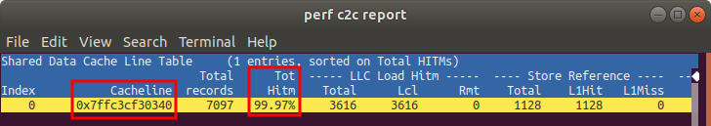
Preventing False Sharing
False sharing happens when two threads modify logically unrelated variables that happen to physically sit on the same 64-byte cache line.
Every time Core 1 writes to its variable, the cache-coherence protocol invalidates the entire line for Core 2 - even though Core 2's variable never actually changed. Core 2 is forced to reload the whole cache line.
Fix: Force independent hot variables onto separate cache lines using alignas(64).
On Linux, perf c2c record followed by perf c2c report can be used to analyze cross-core cache line contention and point directly at the colliding instances. Guide

Slide 32
Preventing False Sharing
Vulnerable to false sharing
Padded to isolate cache lines
// Producer core writes head, consumer core writes tail -
// but they're likely on the same cache line
struct RingBufferCursors {
std::atomic<size_t> head{0}; // written by producer
std::atomic<size_t> tail{0}; // written by consumer
};
// Each cursor gets its own cache line -
// no cross-core invalidation
struct alignas(64) PaddedCounter {
std::atomic<size_t> value{0}; // padding for 64B align
};
struct RingBufferCursors {
PaddedCounter head; // producer's cache line
PaddedCounter tail; // consumer's cache line
};

Slide 33
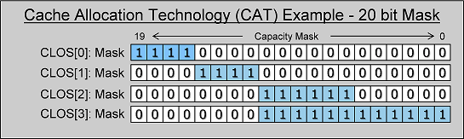
Intel CAT: Partitioning the Cache itself
The last level cache (LLC) is allocated on a first-come first-served basis with no restrictions/isolation.
So a noisy neighbor can evict important data from the shared cache - called cache pollution.
Intel Cache Allocation Technology fixes this by letting you carve the LLC into isolated partitions.
Each partition is dedicated to a Class of Service (CLOS) - group of threads/applications/VMs.
Each partition is described by a Capacity Bit Mask (CBM), with one bit per “way” of the cache.
So a 20-way set-associative cache will have a 20 bit mask for each CLOS specifying which blocks in a set it has access to. Each bitmask must have contiguous runs of set bits.
Configured through resctrl, a virtual file system exposed by the kernel.
Reference

Slide 34
Intel CAT: Partitioning the Cache itself
resctrl configuration (Linux)
# Mount the resctrl filesystem (root-owned control interface)
mount -t resctrl resctrl /sys/fs/resctrl
# Shrink the default group to ways 0-15 (contiguous)
echo "L3:0=0x0ffff" > /sys/fs/resctrl/schemata
# Create a class of service for a latency-critical task
mkdir /sys/fs/resctrl/critical_task
echo "L3:0=0xf0000" > /sys/fs/resctrl/critical_task/schemata # highest 4 ways
# Make the allocation exclusive (no other group may use these ways)
echo "exclusive" > /sys/fs/resctrl/critical_task/mode
# Assign the task's PID to this class of service
echo <PID> > /sys/fs/resctrl/critical_task/tasks

Slide 35
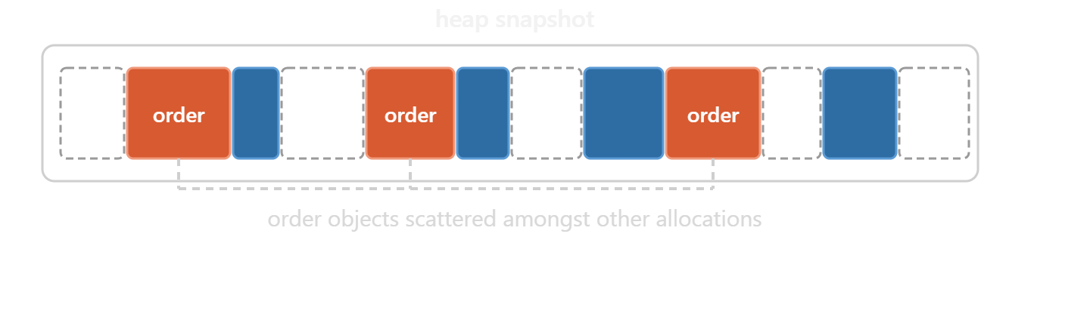
Memory Pools: The Problem
new and malloc scatter objects across the heap essentially at random relative to each other, destroying any cache locality between logically-related objects.
Dynamic allocation also prefixes every allocation with a hidden memory control block tracking size, free-list links, and allocator metadata - wasted bytes on every single object, and a source of heap fragmentation over the life of the process.
Allocation and deallocation require frequent system calls to request or return memory from the OS, adding unpredictable, non-deterministic latency to the hot path.

Slide 36
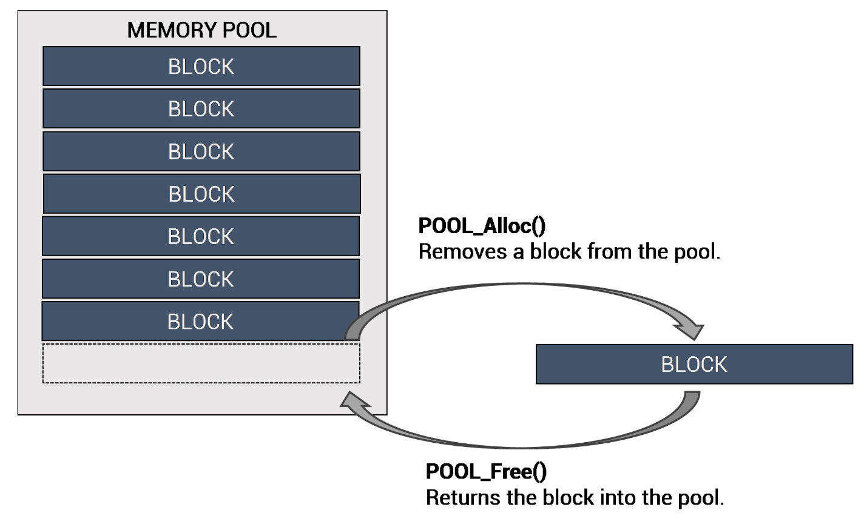
Memory Pools: The Fix
A memory pool preallocates one large, contiguous array of objects at startup.
This eliminates allocation calls from the hot path entirely - you're just claiming and releasing slots in an array you already own.
To track which slots are free, pools commonly keep a separate stack-like array of free indices.
Allocating pops an index off the stack; deleting pushes it back on.
The stack's LIFO order means the next allocation reuses the slot that was most recently freed - which is likely to still be warm in cache, providing a cache-warming mechanism as a side effect.

Slide 37
Memory Pools
Index-based free-list pool
template <typename T, size_t Capacity>
class MemoryPool {
public:
MemoryPool() {
// Populate free index stack with every index, at startup -
// this is the only place we pay real allocation cost
for (size_t i = 0; i < Capacity; ++i) {
freeIndices_[i] = Capacity - 1 - i;
}
freeTop_ = Capacity;
}
T* acquire() {
if (freeTop_ == 0) return nullptr; // pool exhausted
size_t idx = freeIndices_[--freeTop_];
return &storage_[idx]; // recently-freed slot: cache-warm
}
void release(T* obj) {
size_t idx = static_cast<size_t>(obj - storage_.data());
freeIndices_[freeTop_++] = idx;
}
private:
std::array<T, Capacity> storage_; // one contiguous block
std::array<size_t, Capacity> freeIndices_;
size_t freeTop_ = 0;
};
static MemoryPool<Order, 100000> orderPool;
Order* o = orderPool.acquire();

Slide 38
Huge Pages & TLB Optimization
The Translation Lookaside Buffer (TLB) is a small hardware cache that maps virtual memory addresses to physical ones. Every memory access needs a TLB lookup, and a miss forces a slow, multi-level “page walk” through the page tables in the hierarchy.
Standard pages are 4KB. With a TLB of, say, 64-1536 entries, you only cover a few megabytes of address space before you start missing constantly - this is called TLB thrashing, and it shows up as latency spikes.
The fix - huge pages: Mapping memory in 2MB (or 1GB) pages instead of 4KB pages means a single TLB entry covers up to 512x more memory. The same TLB that used to cover a few MB now reaches into the gigabytes, and the page walk itself is one level shallower, so even a miss is cheaper.
This prevents the memory accesses corresponding to a large entity, like a monolithic index or a large market-data ring buffer, from being spread out over several pages that keep getting evicted from RAM.

Slide 39
Huge Pages & TLB Optimization
Comparison | 4KB pages | 2MB huge pages
TLB coverage (1536 entries) | around 6 MB | around 3 GB
Page walk depth | 4 levels | 3 levels
Best for | small, varied allocations | large, consistent working sets
Transparent Huge Pages vs. hugetlbfs: THP is the kernel's default mechanism for assembling huge pages automatically, on demand - finding 512 contiguous free 4KB pages right when the allocation happens.
Under memory pressure, that search can trigger defragmentation and compaction, stalling the process for milliseconds. By contrast, the pseudo file system hugetlbfs lets huge pages be reserved explicitly at boot, before memory gets fragmented, so pools can be mapped from that pre-reserved region.
Pinning a memory with mlockall guarantees that the pages allocated are never swapped out. Huge pages allocated using hugetlbfs are by default not swappable.
Reference: https://www.hudsonrivertrading.com/hrtbeat/low-latency-optimization-part-2

Slide 40
Huge Pages & TLB Optimization
Transparent Huge Pages
Hugetlbfs
// Ask the kernel to try promoting to huge pages
void* pool = mmap(nullptr, poolSizeBytes,
PROT_READ | PROT_WRITE,
MAP_PRIVATE | MAP_ANONYMOUS,
-1, 0);
if (pool == MAP_FAILED) {
perror("mmap failed");
std::abort();
}
madvise(pool, poolSizeBytes, MADV_HUGEPAGE);
// Promotion typically happens on first touch
std::memset(pool, 0, poolSizeBytes);
// Lock to prevent the pages from swapping out
mlockall(MCL_CURRENT | MCL_FUTURE);
// Reserve and use huge pages explicitly
void* pool = mmap(nullptr, poolSizeBytes,
PROT_READ | PROT_WRITE,
MAP_PRIVATE | MAP_ANONYMOUS | MAP_HUGETLB,
-1, 0);
if (pool == MAP_FAILED) {
perror("mmap: huge page allocation failed");
std::abort();
}
// Huge pages allocated using Hugetlbfs are never swapped out

Slide 41
Real-Time Scheduling
By default, threads run under SCHED_OTHER, the Completely Fair Scheduler (CFS).
Every runnable thread gets a time-slice proportional to its priority, current waiting time, etc.
To prevent your latency-critical thread from getting preempted, you can use real-time policies.
SCHED_FIFO runs a thread until it yields or blocks - no timer preemption at all.
SCHED_RR does round robin scheduling, with equal time given to threads at the same priority.
You can set a run time priority between 1-99, but capabilities like CAP_SYS_NICE are needed.
As a safety measure RT throttling reserves ~5% of every CPU-second for other tasks by default.
Latency-critical setups often disable this throttle (sched_rt_runtime_us = -1).
SCHED_FIFO is usually paired with core isolation to get an uninterrupted core.

Slide 42
Real-Time Scheduling
Setting SCHED_FIFO
void makeRealTime() {
sched_param param{};
param.sched_priority = 80; // 1-99
int rc = pthread_setschedparam(
pthread_self(), SCHED_FIFO, &param);
if (rc != 0) {
fprintf(stderr, "setschedparam: %s\n", strerror(rc));
}
}
void pinToCore(int core) {
cpu_set_t cpuset;
CPU_ZERO(&cpuset);
CPU_SET(core, &cpuset);
pthread_setaffinity_np(
pthread_self(),
sizeof(cpu_set_t), &cpuset);
}

Slide 43
Recap: Fixes for each problem
Branch Mispredictions
Cache Misses
Eliminate branches where possible, go branchless (ternary/CMOV, boolean arithmetic, bitmasking, lookup tables), and hint the compiler for predictable branches ([[likely]]/[[unlikely]], PGO).
Understand the 64-byte cache line, prefetch ahead of need, warm the cache before the clock starts, and pack your structs to avoid wasted padding.
Memory Allocation Overhead
Unoptimized Access Patterns
Preallocate everything in a memory pool at startup, avoid calling new/malloc on the hot path.
Favor contiguous containers over pointer-chasing ones, avoid false sharing with alignas, and use huge pages when your working set is large but consistent.
Several of these techniques have real tradeoffs and only pay off in the right context.
The only way to know is to profile first, change one thing at a time, and measure again.
Reference: https://www.aussieai.com/pdf/CPP-Ultra-Low-Latency-Spuler-2025.pdf

